Slide 1


Transfer Learning for Non-Autoregressive Sequence Generation
Presented By: Andrew Koh Jin Jie
Supervisor: Assoc Prof. Chng Eng Siong

Slide 2
About Me
Andrew Koh Jin Jie
Second Year PHD student, matriculated in Aug 2019
Year 1 TAC appraisal passed
CGPA: 4.08
Publications:
B. P. Yap, A. Koh, and E. S. Chng, “Adapting BERT for Word Sense Disambiguation with Gloss Selection Objective and Example Sentences,”arXiv:2009.11795[cs], Oct. 2020, arXiv: 2009.11795.
Examining Transfer Learning for Non-autoregressive Machine Translation, pending, (this work)
Workshops:
1. JSALT 2020, https://www.clsp.jhu.edu/workshops/20-workshop/

Slide 3
Outline
1. Introduction
1.1 What is Non-Autoregressive Sequence Generation
1.2 Why do we need Non-Autoregressive Sequence Generation
1.3 How is Non-Autoregressive Sequence Generation done?
1.4 What are the current limitations of Non-Autoregressive Sequence Generation?
1.5 Research Motivation
2. Contributions
2.1 Transfer Learning for Non-Autoregressive Sequence Generation
2.2 Past and Future N-gram Language Modeling
2.3 Hysteresis decoding
2.4 Examining the importance of the transformer layers
3. Conclusion and Future Work

Slide 4
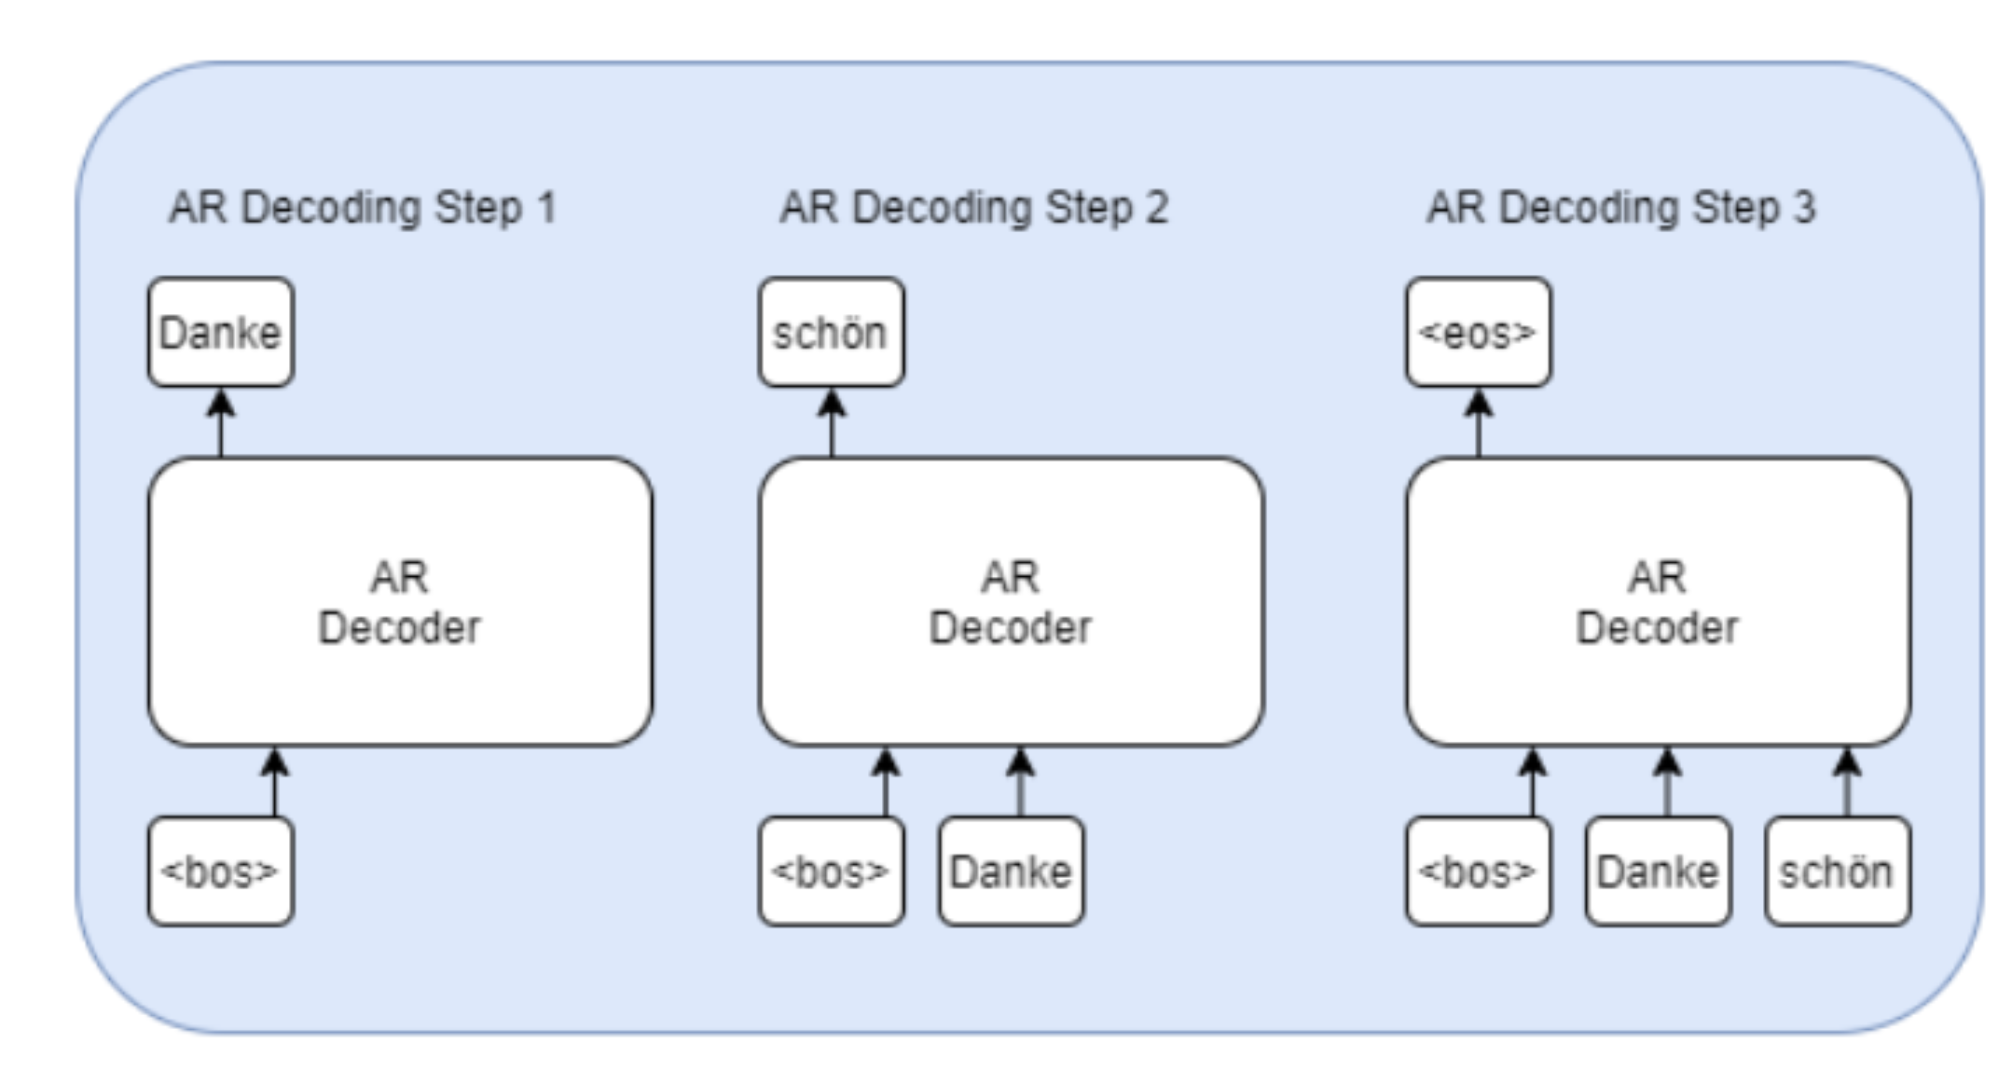
What is Non-Autoregressive Sequence Generation?
What is Autoregressive Sequence Generation?
Causal Left-to-right generation, 1 token/word at a time.
Figure: Autoregressive model applied to Machine Translation
[1] J. Gu, J. Bradbury, C. Xiong, V. O. K. Li, and R. Socher, Non-autoregressive neural machine translation, 2018. arXiv: 1711.02281 [cs.CL].
[2] A. Vaswani, N. Shazeer, N. Parmar, J. Uszkoreit, L. Jones, A. N. Gomez, L. Kaiser, and I. Polosukhin, “Attention Is All You Need,” arXiv:1706.03762 [cs], Dec. 2017, arXiv: 1706.03762.
Notes:
Autoregressive models, lstm, rnns, transformers
- causal, depends on a previous step
- in sequence generation, it is left to right,
- typically 1 token at a time with each forward pass through the decoder
explain: decoding step 1
dec step 2
dec step 3

Slide 5
What is Non-Autoregressive Sequence Generation?
Where has Autoregressive Sequence Generation been used?
Machine Translation
Summarization
GPT-2
And many more!
Question Answering
Story Generation
[1] A. Vaswani, N. Shazeer, N. Parmar, J. Uszkoreit, L. Jones, A. N. Gomez, L. Kaiser, and I. Polosukhin, “Attention Is All You Need,” arXiv:1706.03762 [cs], Dec. 2017, arXiv: 1706.03762.
[2] A. Radford, J. Wu, R. Child, D. Luan, D. Amodei, and I. Sutskever, “Language Models are Unsupervised Multitask Learners,” en, p. 24

Slide 6
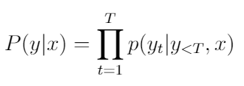
What is Non-Autoregressive Sequence Generation?
What is Autoregressive Sequence Generation?
Formulated as:
Final generated output
Encoder Input
current generated token
Previous decoder output
Encoder input
[1] J. Gu, J. Bradbury, C. Xiong, V. O. K. Li, and R. Socher, Non-autoregressive neural machine translation, 2018. arXiv: 1711.02281 [cs.CL].
Notes:
Formulated as a probability function where y, the next token, is generated conditioned on the previous sequence x.
This can be expanded as a probability chain rule where the final sequence is the product of all generated tokens before it.

Slide 7
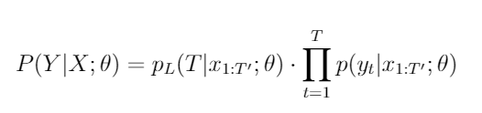
What is Non-Autoregressive Sequence Generation?
What is Non-Autoregressive Sequence Generation?
Removal of Autoregressive Factorization across time
Remove the conditional dependence on previous steps!
Output Sequence
Input Sequence
Latent Variable
Length Modeling
Part or all of the next sequence
Input
Sequence
Latent variable
[1] J. Gu, J. Bradbury, C. Xiong, V. O. K. Li, and R. Socher, Non-autoregressive neural machine translation, 2018. arXiv: 1711.02281 [cs.CL].
Notes:
Moving on
NA sequence generation
- removes autoregressive factorization
- instead of relying on previous sequence to generate the next single token, we try to generate parts or all of the sequence using the current input

Slide 8
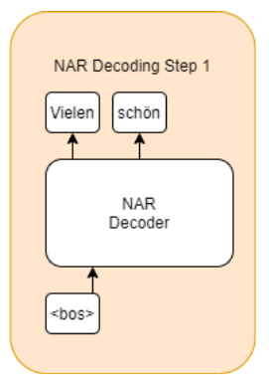
What is Non-Autoregressive Sequence Generation?
What is Non-Autoregressive Sequence Generation?
Removal of Autoregressive Factorization across time
Allows for greatly increased decoding speed
Figure: Non-Autoregressive model applied to Machine Translation
[1] J. Gu, J. Bradbury, C. Xiong, V. O. K. Li, and R. Socher, Non-autoregressive neural machine translation, 2018. arXiv: 1711.02281 [cs.CL].
Notes:
non-autoregressive sequence Allows for greatly increased decoding speed, time and computational power savings, higher efficiency and makes it easier to scale. A NA solution is more attractive for people or companies who want to deploy a sequence generation model, but do not have sufficient computational power.

Slide 9
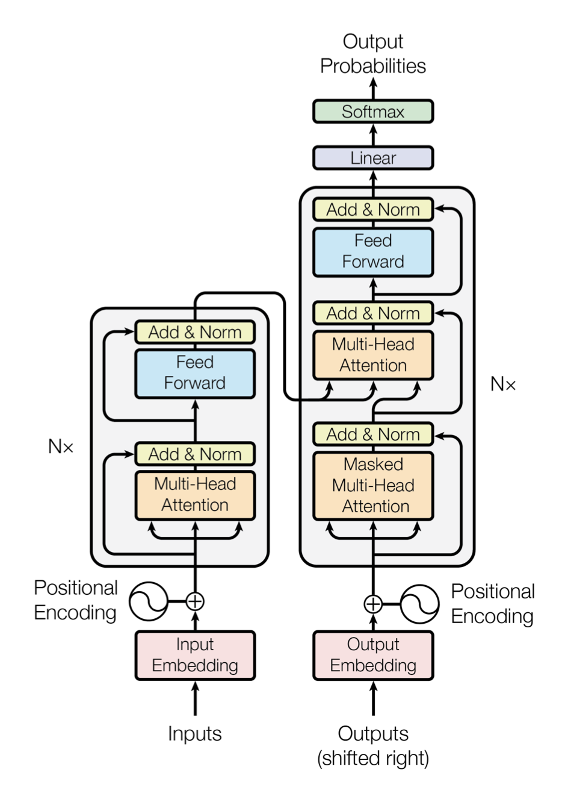
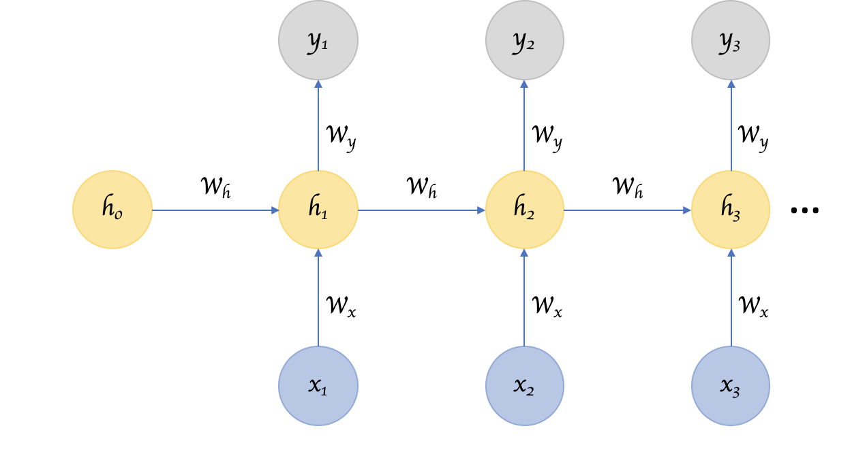
Why do we need Non-Autoregressive Sequence Generation now?
Popularity of Transformer models surpassing RNNs, LSTMs
>
[2] Recurrent Neural Network
[1] Transformer
[1] A. Vaswani, N. Shazeer, N. Parmar, J. Uszkoreit, L. Jones, A. N. Gomez, L. Kaiser, and I. Polosukhin, “Attention Is All You Need,” arXiv:1706.03762 [cs], Dec. 2017, arXiv: 1706.03762.
[2] "Finding Structure in Time“ - https://onlinelibrary.wiley.com/doi/abs/10.1207/s15516709cog1402_1
[3 ] T. Wolf, L. Debut, V. Sanh, J. Chaumond, C. Delangue, A. Moi, P. Cistac, T. Rault, R. Louf, M. Funtowicz, J. Davison, S. Shleifer, P. von Platen, C. Ma, Y. Jernite, J. Plu, C. Xu, T. Le Scao, S. Gugger, M. Drame, Q. Lhoest, and A. Rush, “Transformers: State-of-the-art natural language processing,” in Proceedings of the 2020 Conference on Empirical Methods in Natural Language Processing: System Demonstrations, Online: Association for Computational Linguistics, Oct. 2020, 40 pp. 38–45. doi: 10.18653/v1/2020.emnlp-demos.6.
Notes:
Before the popularity of the transformers in 2017, the defacto model to use for sequence generation was RNN and LSTMs.
The autoregressive property was inherent in the structure of RNN and LSTMs; these models' strength lies capturing temporal properties across time.
The transformer however, did not have this inherent property and hence can be made non-autoregressive

Slide 10
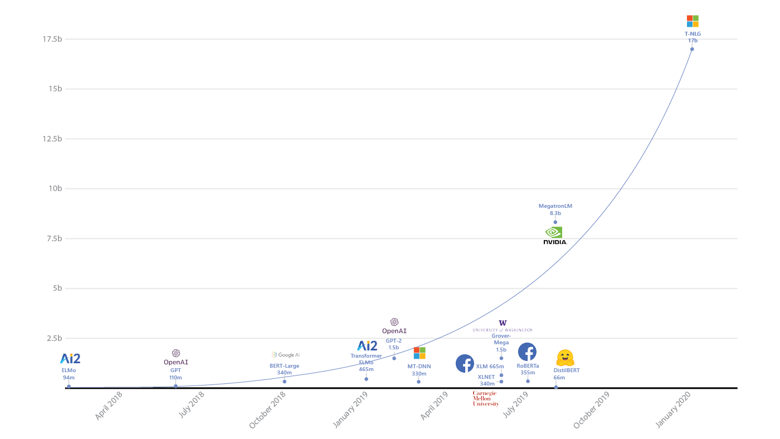
Why do we need Non-Autoregressive Sequence Generation?
2. Increased model sizes over the years
Graph: https://www.microsoft.com/en-us/research/blog/turing-nlg-a-17-billion-parameter-language-model-by-microsoft/
Notes:
Another argument for NAT is the exponential increase of model sizes over the years.
Recall that in autoregressive sequence generation, a single token is generated with a single forward pass through the decoder. A sequence with 50 tokens requires 50 forward passes through the decoder. This, combined with the exponentially increasing model sizes, poses a problems in terms of practicality, energy cost, and time cost.

Slide 11
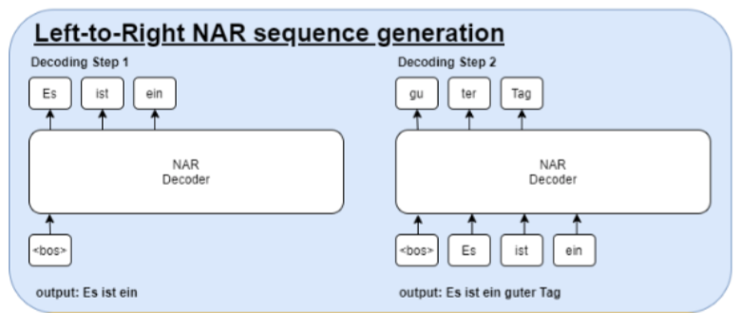
How is Non-Autoregressive Sequence Generation done?
Two approaches
1. Left to right
[1] C. Wang, J. Zhang, and H. Chen, “Semi-Autoregressive Neural Machine Translation,” en, arXiv:1808.08583 [cs], Oct. 2018, arXiv: 1808.08583. [Online].
Notes:
The first approach is reminiscent of the autoregressive sequence generation.
Instead of generating a single token at each decoding step, we can generate a sequence of tokens.
This allows us to speed up decoding by a factor of the length of the generated sequence. For example, generating 4 tokens would give us a theorecctical speed up of 4x

Slide 12
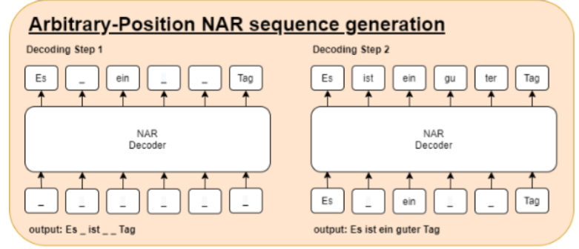
How is Non-Autoregressive Sequence Generation done?
Two approaches
2. Arbitrary Position
[1] X. Ma, C. Zhou, X. Li, G. Neubig, and E. Hovy, “FlowSeq: Non-Autoregressive Conditional Sequence Generation with Generative Flow,” en, arXiv:1909.02480 [cs], Oct. 2019, arXiv: 1909.02480.
[2] J. Gu, C. Wang, and J. Zhao, “Levenshtein Transformer,” en, arXiv:1905.11006[cs], Oct. 2019, arXiv: 1905.11006.
[3] M. Stern, W. Chan, J. Kiros, and J. Uszkoreit, “Insertion Transformer: Flexible Sequence Generation via Insertion Operations,” en, arXiv:1902.03249 [cs, stat], Feb. 2019, arXiv: 1902.03249
Notes:
The second approach is the arbitrary position sequence generation.
This approach has been somewhat more common so far.
This approach can be thought as having a blank canvas at the start, and then filling in parts of the canvas with each decoding step

Slide 13
What are the current limitations of Non-Autoregressive Sequence Generation?
Quality-Speed Tradeoff
Decoding Speed
Translation Quality
[1] X. Ma, C. Zhou, X. Li, G. Neubig, and E. Hovy, “FlowSeq: Non-Autoregressive Conditional Sequence Generation with Generative Flow,” en, arXiv:1909.02480 [cs], Oct. 2019, arXiv: 1909.02480.
[2] J. Gu, C. Wang, and J. Zhao, “Levenshtein Transformer,” en, arXiv:1905.11006[cs], Oct. 2019, arXiv: 1905.11006.
Notes:
As NA sequence generation is an emerging field, there are several limitations to these models.
The most obvious limitation currently is the quality-speed tradeoff
As the decoding speed of the non-autoregressive model increases, translation quality declines

Slide 14
What are the current limitations of Non-Autoregressive Sequence Generation?
Quality-Speed Tradeoff
[1] C. Wang, J. Zhang, and H. Chen, “Semi-Autoregressive Neural Machine Translation,” en, arXiv:1808.08583 [cs], Oct. 2018, arXiv: 1808.08583. [Online].
[2] J. Gu, J. Bradbury, C. Xiong, V. O. K. Li, and R. Socher, Non-autoregressive neural machine translation, 2018. arXiv: 1711.02281 [cs.CL].
Notes:
As NA sequence generation is an emerging field, there are several limitations to these models.
The most obvious limitation currently is the quality-speed tradeoff
As the decoding speed of the non-autoregressive model increases, translation quality declines

Slide 15
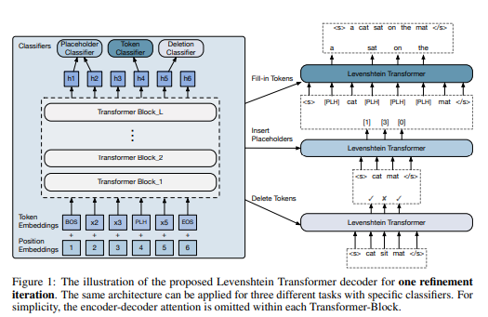
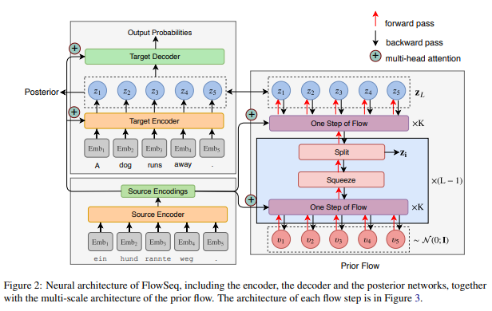
What are the current limitations of Non-Autoregressive Sequence Generation?
2. Complex solutions required
[1] FlowSeq
[2] Levenshtein Transformer
[1] X. Ma, C. Zhou, X. Li, G. Neubig, and E. Hovy, “FlowSeq: Non-Autoregressive Conditional Sequence Generation with Generative Flow,” en, arXiv:1909.02480 [cs], Oct. 2019, arXiv: 1909.02480.
[2] J. Gu, C. Wang, and J. Zhao, “Levenshtein Transformer,” en, arXiv:1905.11006[cs], Oct. 2019, arXiv: 1905.11006.
Notes:
Complex solutions required
Whether this is a limitation or not is arguable;
but having to reinvent the wheel prevents us from using models and solutions already tried and tested in autoregressive decoding.
For instance, flowseq and the levenshtein transformer require a complicated pipeline of predicting tokens between the encoder and decoder. Even though these novel models use the transformer as the foundational model, the added mechanisms and pipeline prevents us from using existing work in the autoregressive literature.

Slide 16
What are the current limitations of Non-Autoregressive Sequence Generation?
2. Case Study: Complex solutions required
1. Classifier prediction
4. Fill in placeholders
3. Placeholder Insertion
N
2. Token Deletion
Figure: Levenshtein Transformer
[1] J. Gu, C. Wang, and J. Zhao, “Levenshtein Transformer,” en, arXiv:1905.11006[cs], Oct. 2019, arXiv: 1905.11006.
Notes:
Here is a quick case study of an arbitrary position NAR sequence generation. I will briefly go through the model’s pipeline.
The encoder of the model first begins by taking in the input, and then predicting the outcome of several classes. Then, the predicted classes are passed to the decoder on the right, which then chooses to either delete or keep the tokens in the decoder input. After which, the decoder will then decide to predict placeholders to add into the decoder sequence. Then finally, then decoder will fill in the placeholder tokens.
This whole pipeline is a 4 step process. Keep in mind that the decoding process is iterated several times. Any errors in this 4-step pipeline will accumulate and affect the final output sequence

Slide 17
Research Motivations
Is it possible to convert a pretrained autoregressive model to a non-autoregressive model using transfer learning?
Is the n-gram prediction task sufficient for non-autoregressive sequence generation?
Which layers in the transformer architecture are instrumental for better performance in non-autoregressive sequence generation?
Notes:
Therefore, our work aims to reduce the complexity of current NAR models and combat the current limitations in non-autoregressive sequence generation.
We ask these 3 research questions:

Slide 18
Outline
1. Introduction
1.1 What is Non-Autoregressive Sequence Generation
1.2 Why do we need Non-Autoregressive Sequence Generation
1.3 How is Non-Autoregressive Sequence Generation done?
1.4 What are the current limitations of Non-Autoregressive Sequence Generation?
1.5 Research Motivation
2. Contributions
2.1 Transfer Learning for Non-Autoregressive Sequence Generation
2.2 Past and Future N-gram Language Modeling
2.3 Hysteresis decoding
2.4 Examining the importance of the transformer layers
3. Conclusion and Future Work
Notes:
Our contributions are as follows. We propose to use transfer learning for non-autoregressive sequence generation

Slide 19
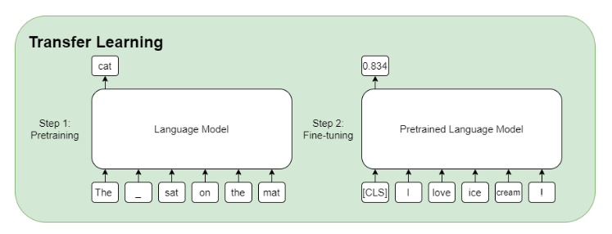
2.1 Transfer Learning for Non-Autoregressive Sequence Generation
Figure: A toy example of how transfer learning works
[1] B. P. Yap, A. Koh, and E. S. Chng, “Adapting BERT for Word Sense Disambiguation with Gloss Selection Objective and Example Sentences,”arXiv:2009.11795[cs], Oct. 2020, arXiv: 2009.11795
Notes:
Why transfer learning?
As mentioned before, current non-autoregressive models are complex and do not make use of previous AT models. Transfer learning refers to taking a pretrained model, and then adapting the model to another task.
Since there are plenty of autoregressive model out there, this approach allows us to adapt the plethora of pretrained models publicly out there.
In this simple example, a language model is trained on the language modeling task, and then finetuned on a sentiment analysis task. In my published paper, I also used this approach for adapting a pretrained language model to a word sense disambiguation.
In this work for non-autoregressive machine translation, we first take a pretrained language model, and then fine tune on the past and future n-gram language modelling task.

Slide 20
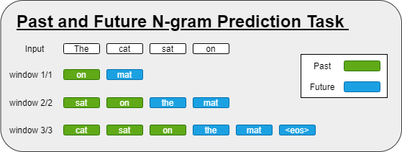
2.2.1 Past and Future N-gram Language Modeling Task
Sequence Refinement
Sequence Generation
Notes:
What is the past and future n-gram language modelling task? Simply put, at every decoding step, we predict an n-gram of past tokens, and another n-gram of future tokens. In this example, window 2/2 refers to predicting 2 tokens In the past, and 2 tokens in the future. When decoding, we can simply append the future tokens to decoder input, and we can use the past tokens for sequence refinement. A future window size of 2 means that there is a speedup of 2 when decoding.
This task is simple and straightforward, and allows us to reuse many models publicly available, which uses the transformer as the foundation.

Slide 21
2.2.1 Past and Future N-gram Language Modeling Task
Notation: window 3/3
past window size: 3
future window size: 3

Slide 22
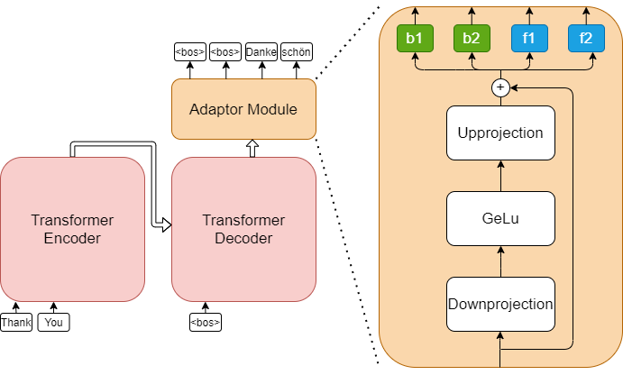
2.2.2 Model Variant
Figure: Adaptor modules appended to the transformer model
[1] N. Houlsby, A. Giurgiu, S. Jastrzebski, B. Morrone, Q. de Laroussilhe, A. Gesmundo, M. Attariyan, and S. Gelly, “Parameter-Efficient Transfer Learning for NLP,” en, arXiv:1902.00751 [cs, stat], Jun. 2019, arXiv: 1902.00751. [Online]. Available: http://arxiv.org/abs/1902.00751
Notes:
How can we change our model to perform these tasks? We do this by simply adding adaptor modules to the model. Adaptor modules are very small in terms of parameters, and do not add much to the training of the model. We use a variant of these modules, and therefore we can easily modify the output of the transformer to predict a ngram of tokens. This is straightforward, simple, and does not require a complicated pipeline of predictions. At every decoding step, we can predict the next few tokens using the future window, and we can also use the past window for sequence refinement.

Slide 23
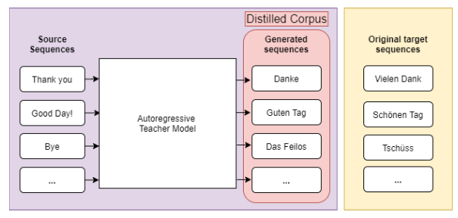
2.2.3 Experimental Setup and Details
Dataset: WMT14 English-German dataset
Original Version
Distilled Version
550
Figure: Sequence level knowledge distillation applied to the original corpus

Slide 24
2.2.3 Experimental Setup and Details
Dataset: WMT14 English-German dataset
Original Version
Distilled Version
Model training setup
From scratch vs using Transfer learning
Original data vs Distilled data
Evaluation setup
Metric: BLEU4 (0-100), measures 4-gram overlap
Decoded using argmax decoding, beam search, and hysteresis decoding.

Slide 25
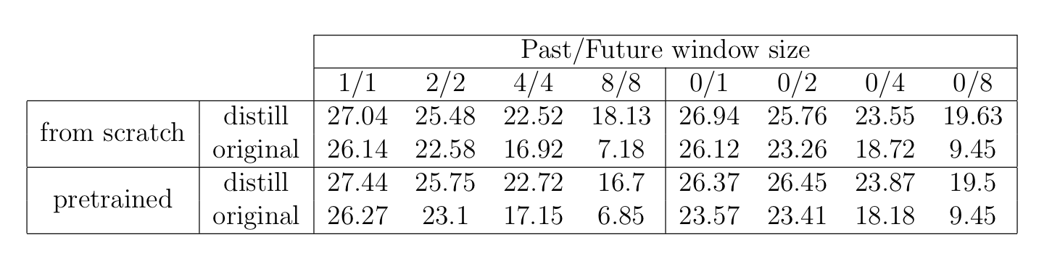
Findings 1. Effectiveness of transfer learning
Comparison to autoregressive model: 26.94 BLEU4
Notes:
I will now go through my findings. Both models trained from scratch and a pretrained model obtained comparable results to an autoregressive model. We can see that our model suffers from the same trade off. As the decoding speed increases, the quality of the non-autoregressive model decreases.

Slide 26
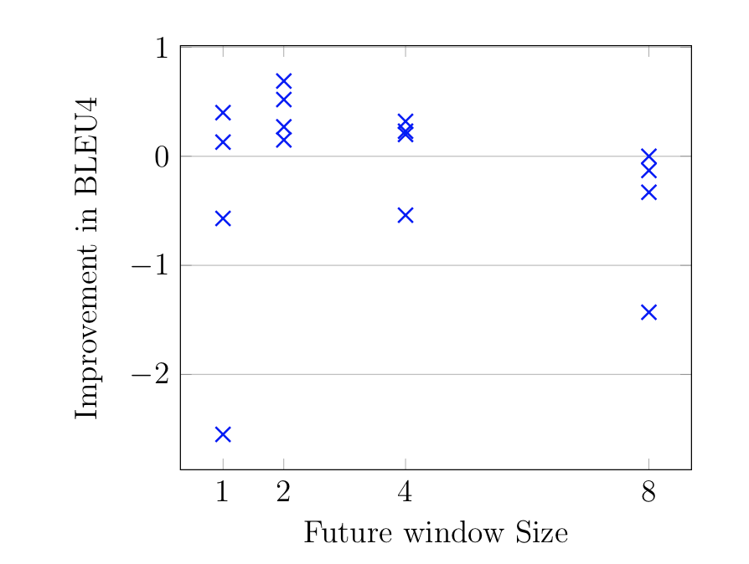
Findings 1. Effectiveness of transfer learning
Improvement in BLEU4 score when using transfer learning
Improvement in BLEU4 =
BLEU4 of model using transfer learning –
BLEU4 of model trained from scratch
Notes:
The improvement is shown here in the graph. I calculate the improvement in BLEU4 score by deducting the using a pretrained model, versus training from scratch. For smaller window sizes, the improvement using transfer learning is more apparent. However, as the window sizes get larger, the benefits are reduced. We hypothesize that this is because for larger window sizes, the information from a pretrained autoregressive model is insufficient to accurately predict for a larger ngram. We find that transfer learning does indeed works in converting a pretrained autoregressive model to a non-autoregressive model. However, its benefits seem to be diminished for larger window sizes, and its effects are not consistent.

Slide 27
Findings 2. Effectiveness of transfer learning on different types of data
Comparison to autoregressive model: 26.94 BLEU4
Notes:
Moving on to finding number 2. we compare the effectiveness of transfer learning on different types of data. Many other work in non-autoregressive sequence generation also reported a much better performance when training on distilled data over original data. Distilled data refers to using the output of an autoregressive model to create a new set of data. We also train our models on both original and distilled data. These are the results in tabular form.

Slide 28
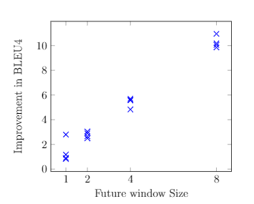
Findings 2. Effectiveness of transfer learning on different types of data
Improvement in BLEU4 score when using distilled data over original data
Improvement in BLEU =
BLEU4 of model using distilled data –
BLEU4 of model using original data
Notes:
This improvement in BLEU4 score is also shown on a scatter plot here. We also collaborate our findings with other literature. It is clear that at all window sizes, the use of distilled data is more advantageous than the use of original data. Therefore, we also focus on using distilled data for our experiments

Slide 29
RQ1: Is it possible to convert a pretrained autoregressive model to a non-autoregressive model using transfer learning?
Notes:
Yes, it is possible! Using both transfer learning, along with distilled data, we have shown that transfer learning gives us slightly better results than training from scratch.

Slide 30
Findings 3: Effectiveness of argmax sequence refinement
Sequence Refinement
Sequence Generation
Notes:
We will move on to our next finding. Recall that in our past and future n-gram prediction task, the past window can be used for sequence refinement, and the future window is for sequence generation

Slide 31
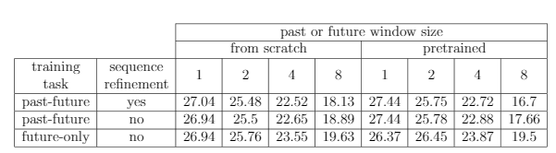
Findings 3: Effectiveness of argmax sequence refinement
Comparison to autoregressive model: 26.94 BLEU4
Notes:
Therefore, to test the effectiveness of argmax sequence refinement, we report our findings in 3 settings. We train 2 models. First, we train a model on the past-and future training task and use argmax sequence refinement along with decoding. The results are shown in the first and second row are the same model with sequence refinement, and the same model without sequence refinement. We also train a model without the past window, meaning that there is only the future window. The results for this model are shown in the 3rd row.
Comparing the results of the argmax sequence refinement with the models without, argmax sequence refinement does not seem to help. We hypothesize that argmax decoding is too naïve and therefore insufficient for sequence refinement. Therefore, we

Slide 32
2.3.1 Argmax Decoding
Greedy Decoding method
Generates the most probable token
Shortcomings:
Too naïve for sequence refinement
Notes:
Argmax Decoding is a popular greedy decoding method. It works by choosing the most probable token to be generated during decoding. It works well enough for autoregressive sequence generation, but falls short for non-autoregressive sequence generation. Particularly, it is a naïve decoding method and does not sufficiently fits the needs of sequence refinement.

Slide 33
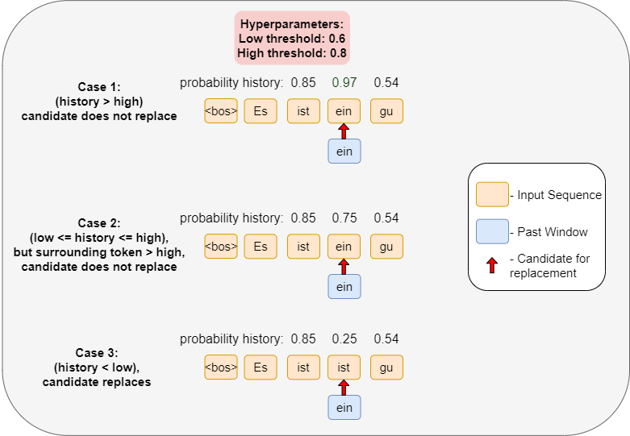
2.3.2 Hysteresis decoding
Notes:
Therefore, we introduce hysteresis decoding, a novel decoding method that is inspired from hysteresis edge tracking from computer vision. Hysteresis decoding uses the probability history of the surrounding tokens as a scaffolding to determine if the candidate token should replace the previously generated token. The low and high thresholds are chosen via a hyperparameter. There are two settings for this decoding method. The first is manually setting the low and high threshold. The second is setting the low and high threshold to be a range of the candidate probability

Slide 34
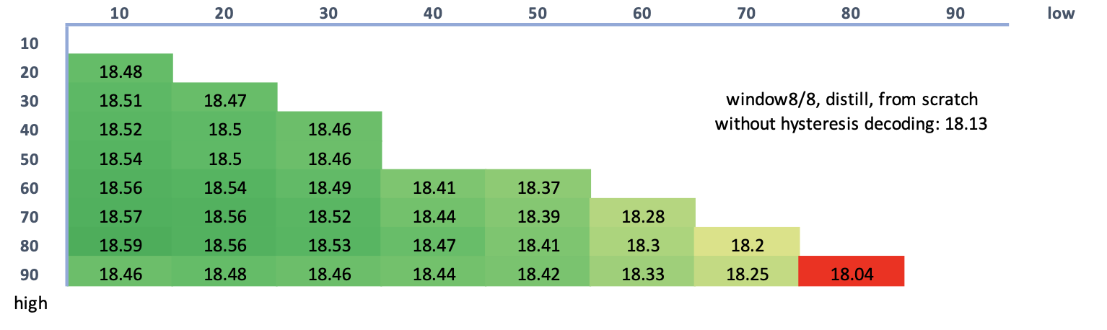
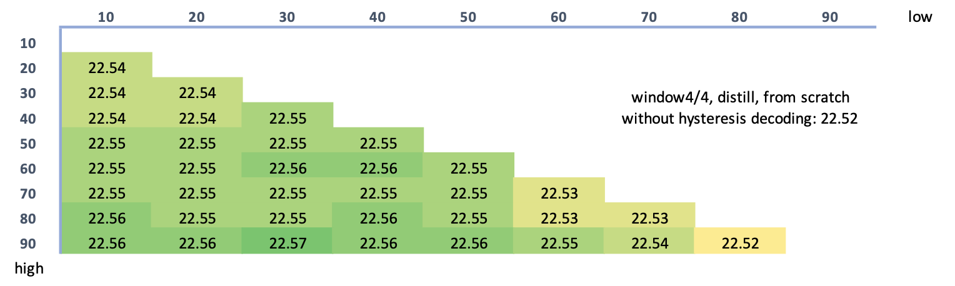
Findings 4: Hysteresis decoding
Manually setting thresholds
Notes:
There are two settings for which we can do hysteresis decoding. The first setting is by manually setting the low and high threshold of hysteresis decoding. Using intervals of 10 from 10 to 90, we test the performance of the models using hysteresis decoding. we find that hysteresis decoding works well for higher window sizes. The results are shown, using a color scheme. The darker the shade of the green, the better the improvement. At higher window size 8/8, the benefits from using hysteresis decoding over argmax decoding is clear. However, this benefit reduces along with the window size. At window size 4/4, there is less of a benefit.

Slide 35
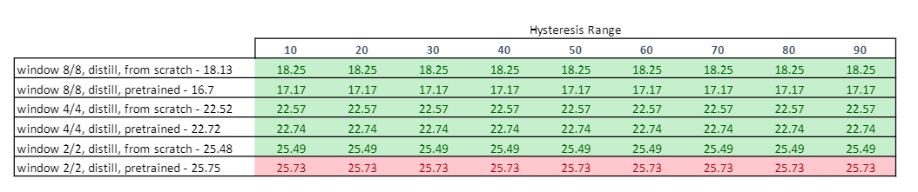
Findings 4: Hysteresis decoding
Automatic Range threshold
Works well and improves score across all possible range
Improvement is more pronounced for high window sizes
Notes:
In this setting, we use an automatic range based on the candidate token probability, and set the low and high threshold dynamically. For example, if the candidate token has a probability of 0.5, a hysteresis range of 10 will set the low threshold to be 0.4 and the high threshold to be 0.6. We find that this setting works well without requiring much hyperparameter tuning for the threshold. However, the benefit is still less than tuning the hyperparameters manually. Like the previous setting, the improvement is more pronounced for higher window sizes, and less pronounced for smaller window sizes

Slide 36
RQ2: Is the n-gram prediction task sufficient for non-autoregressive sequence generation?
Notes:
Yes, it is sufficient! From our results, all of the BLEU scores of our models performed comparatively well. Combined with hysteresis decoding, performance of the models using sequence refinement is improved.

Slide 37
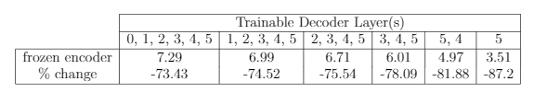
2.4 Importance of the training certain transformer layers for transfer learning
Freeze encoder layers, train the 5 decoder layers
Window 1/1
Notes:
We try to investigate the importance of the transformer layers. We do this by freezing the encoder layers and training some decoder layers. For example, trainable decoder layers 1-5 means that all of the layers in the decoder are trained. We find that across the board, all of the BLEU4 score drops drastically. Therefore, we focus on freezing different layers in both the decoder and the encoder.

Slide 38
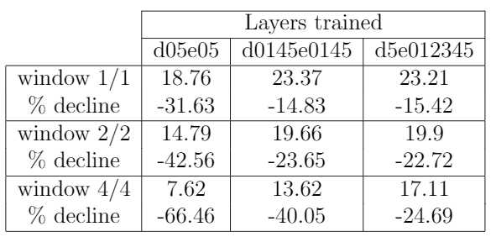
Findings 5: Importance of the training certain layers for transfer learning
Choice of layers to train are more important than number of layers
Notes:
For adapting autoregressive models to non-autoregressive models, we find that choosing the right layers to train is more important than the actual number of layers trained.
The results shown here are the layers which are trained during transfer learning. For example, d05e05 refers to the first and last layers of both decoder and encoder being trainable.
The most important layers to train are the layers in the encoder. As shown in the last column, we can minimize the % decline by training all of the encoder, and only freezing the decoder. This is in contrast to the previous slide, where training only the decoder led to huge performance decrease.
We also find that layers closer to the input and output of the encoder and decoders are important layers to be trained during fine-tuning.

Slide 39
RQ3: Which layers in the transformer architecture are instrumental for better performance in non-autoregressive sequence generation?
Notes:
This brings us to our 3rd RQ. The encoder layers, and the input and output layers are the most important to prevent a huge performance decrease! To summarize, we find choosing the right layers are more important than choosing the number of layers to train.

Slide 40
Outline
1. Introduction
1.1 What is Non-Autoregressive Sequence Generation
1.2 Why do we need Non-Autoregressive Sequence Generation
1.3 How is Non-Autoregressive Sequence Generation done?
1.4 What are the current limitations of Non-Autoregressive Sequence Generation?
1.5 Research Motivation
2. Contributions
2.1 Transfer Learning for Non-Autoregressive Sequence Generation
2.2 Past and Future N-gram Language Modeling
2.3 Hysteresis decoding
2.4 Examining the importance of transformer layers
3. Conclusion and Future Work

Slide 41
3.1 Conclusion
Explored the use of transfer learning
While transfer learning works, it does not produce a significant advantage
Introduced hysteresis decoding for sequence refinement
Improved BLEU4 score for high window sizes
Examined the contribution of different layers in the transformer architecture
Encoder Layers, input and output layers are the most important

Slide 42
3.2 Future Work
Graph encoding to improve the encoder
Non-autoregressive Applications to other tasks
Automated audio captioning
Notes:
Since we have found that the encoder is the most important when doing transfer learning from an autoregressive model to an non-autoregressive model, we suggest using other

